Slide 1

Data Analytics Project :
Bolts Data Studied in New York

Slide 2
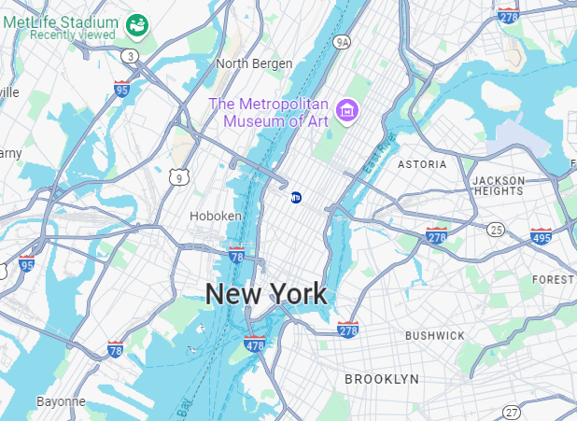
Introduction
How can analyzing Bolt trips in New York help us better understand our target customers, anticipate future trip demand, and predict peak periods to optimize Bolt's performance?
Notes:
one of the most active city in the world , a lot of tourists, events and things happening. Up to 60 Bolt trips per minutes in rush hours, one per second.
How can predict , optimise and give advices to Bolt drivers

Slide 3

Summary
Data Analytics
Case Studies
External Data Sources
Predictions
Conclusion

Slide 4
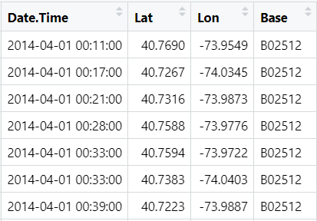
Our DataSets :
Base ? Unique identifier for the hub from which the drivers operate
From April to September
Whats are the Features ?
*
Cleaning :
Spelling and format
null values
Encoding
Duplicates ?
Notes:
6 dataSet marged together
“Base” → This is a unique identifier for the hub from which the drivers operate. So a base does not correspond to one vehicle
DataCleaning :
Verify that dates are correct , and transformed them into date type, lat exist, base well spelled.
No null values
for the duplicates we have a debate but decided to keep everything. NY big city.

Slide 5
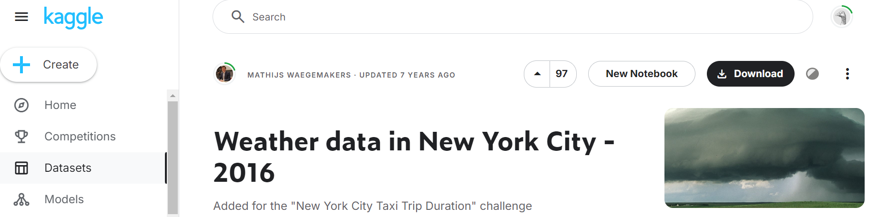
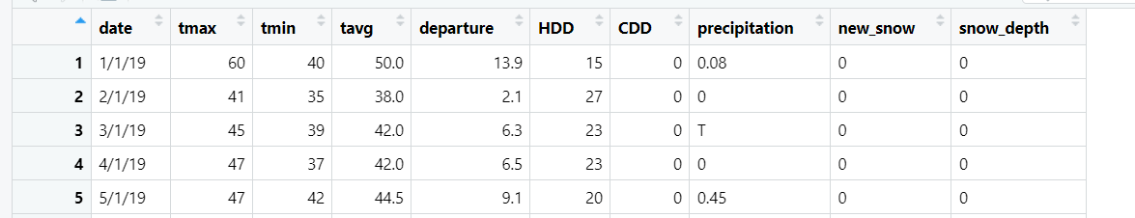
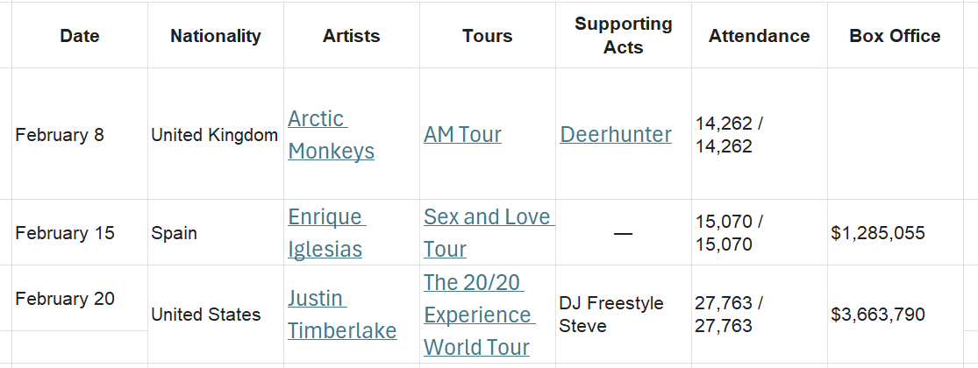
Added DataSets
Weather dt (2016-2019)
Madison Square Garden planning (2014)

Slide 6
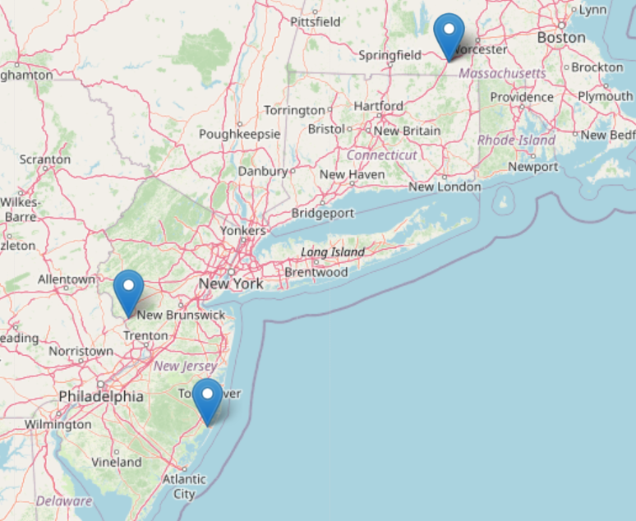
Absurd Values

Slide 7
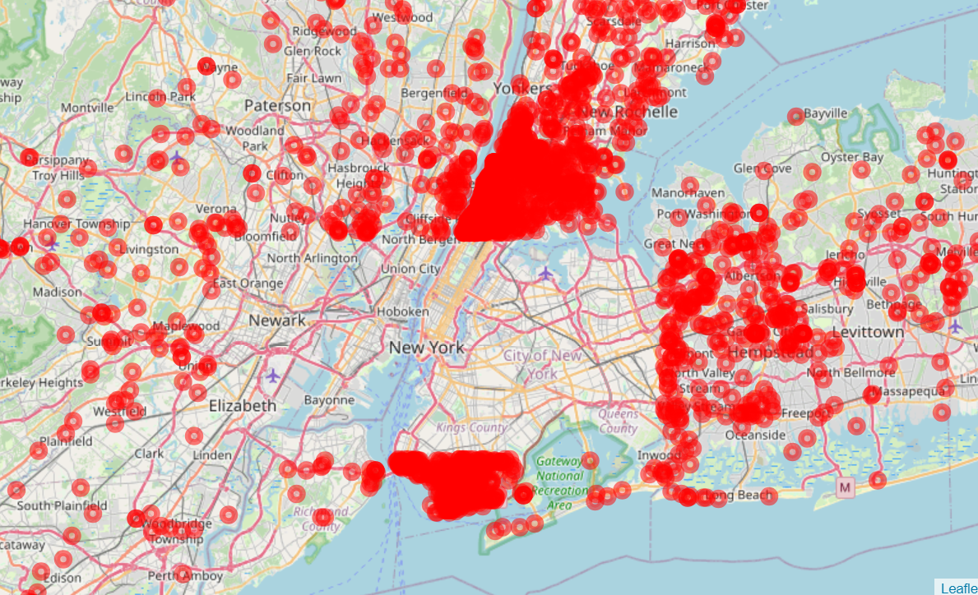
Data Cleaning :
Z-Score :
Number of deleted points : 137 039
Exetening the zone to keep special places

Slide 8

Basic Analytics :
Number of base : 5
Total number of trips : 4 397 288
Mean number of trips per Day : 23 898
per Month : 732 881
day with the most trips ; 2014-09-05 with 42 759 (Usher and US open)
Notes:
Did not use the base very much

Slide 9
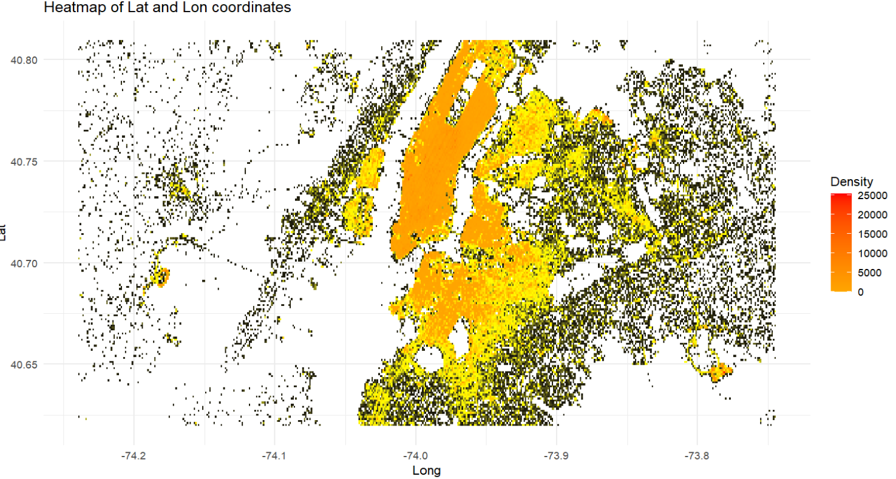
Data Visualization :

Slide 10
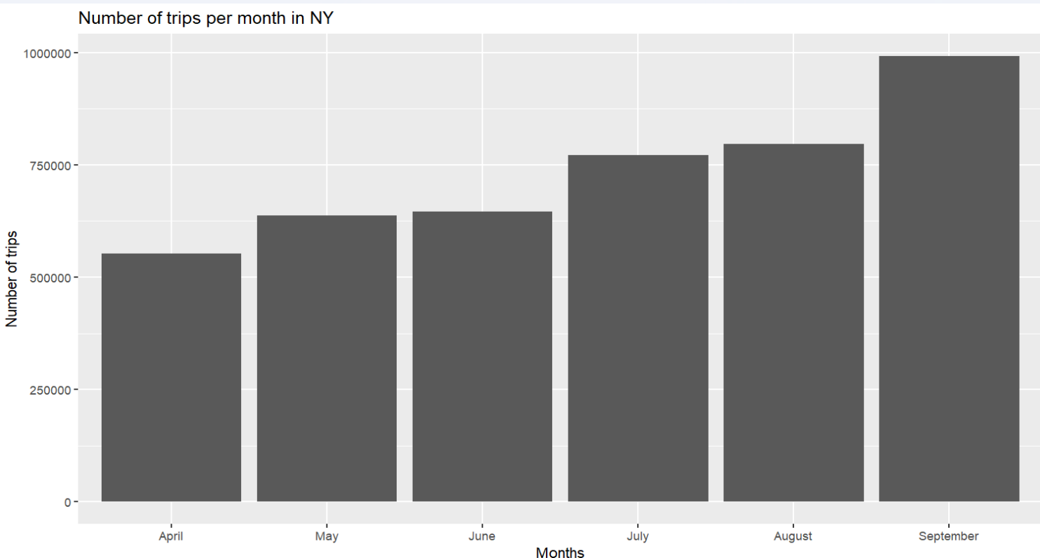
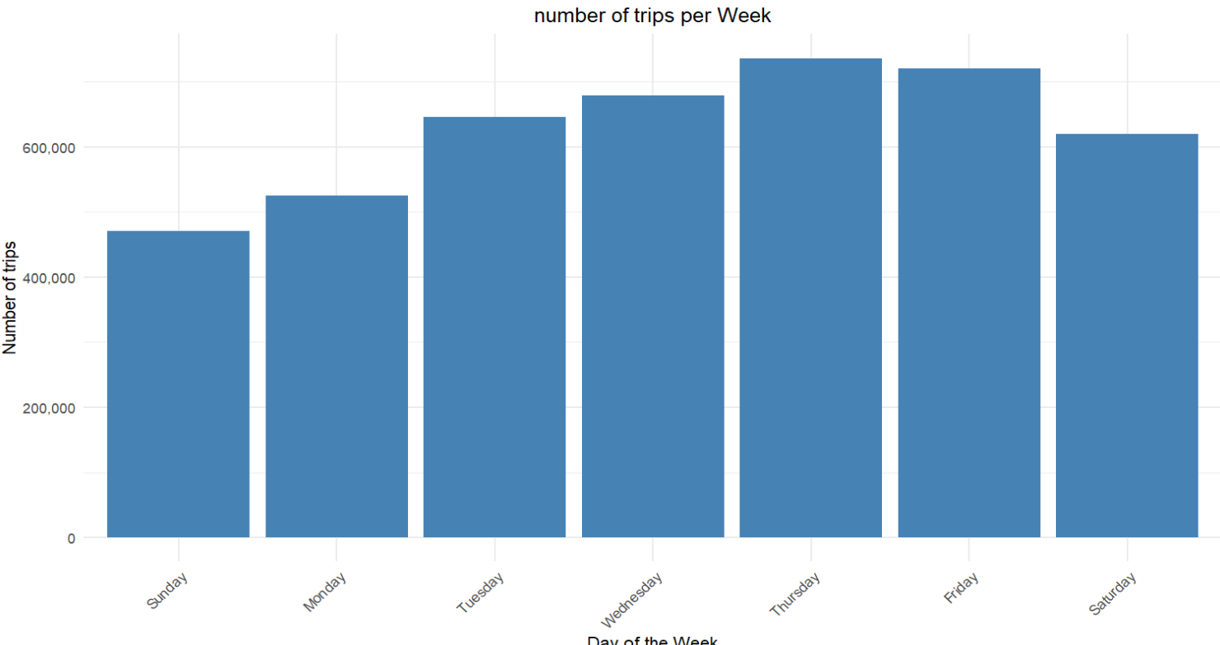
Data Visualization :
Notes:
la taille du texte

Slide 11
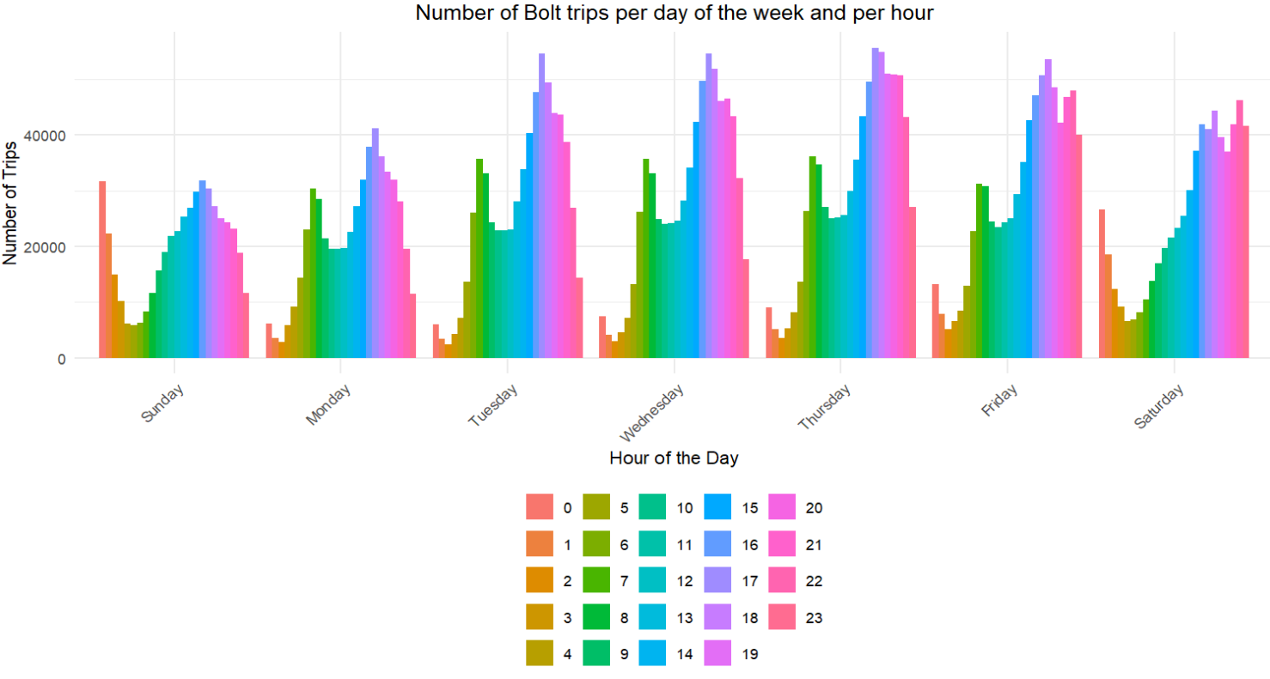
Data Visualization :

Slide 12
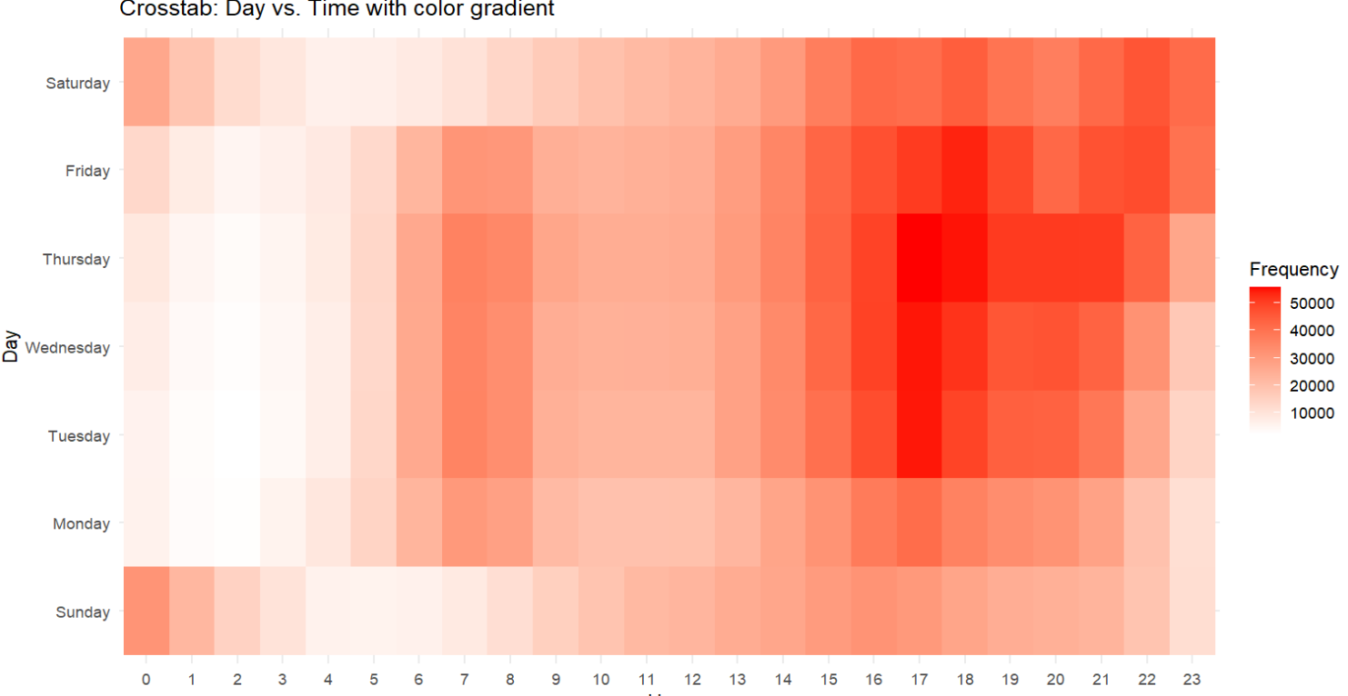
Data Visualization :

Slide 13
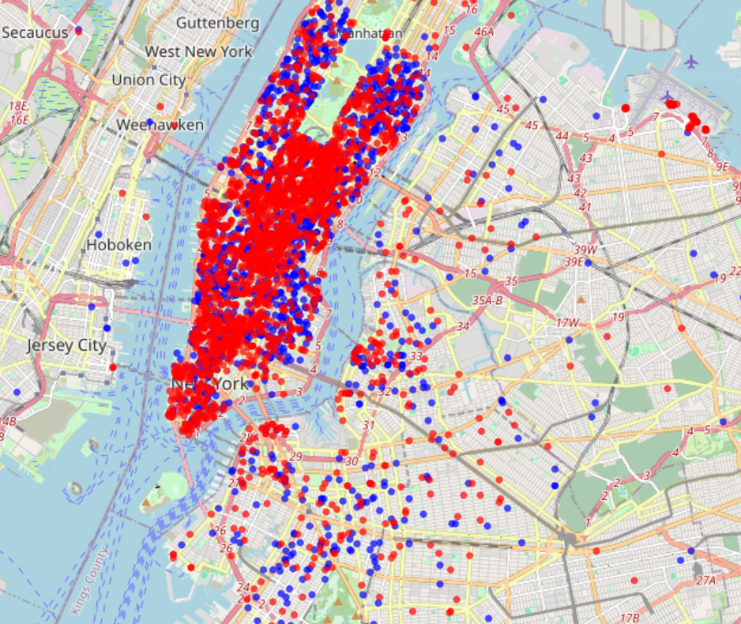


Data Visualization :
Random Week day
7 to 8
17 to 18

Slide 14
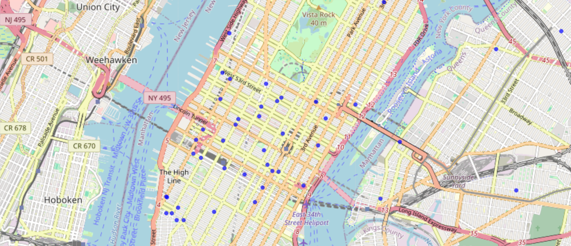
Data Visualization :
Random Week End night
2 to 3

Slide 15
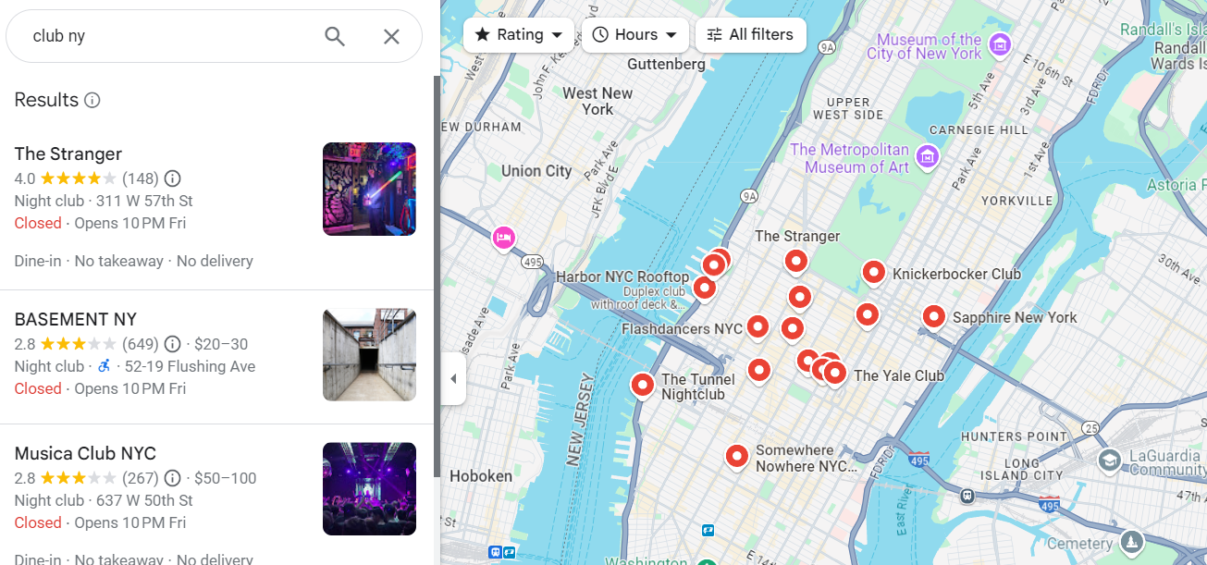
Data Visualization :

Slide 16
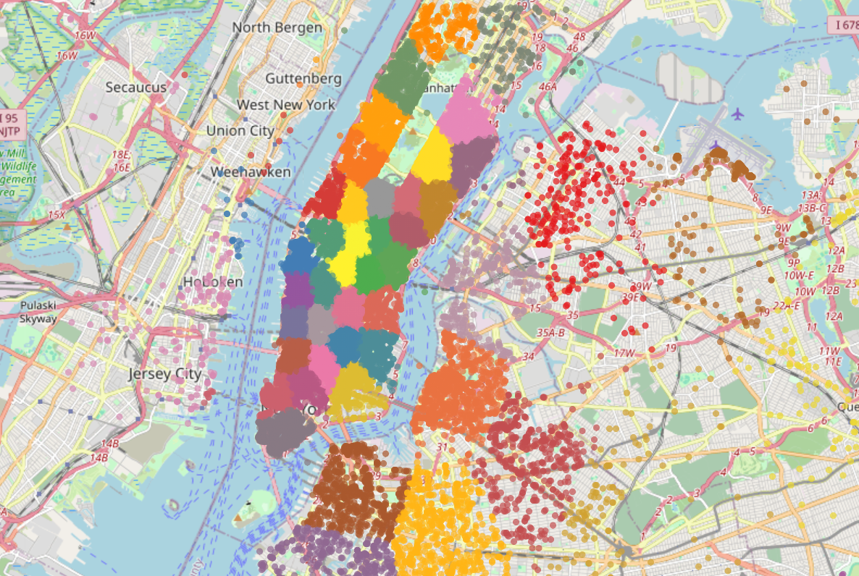
Data Analytics :
Finding Bolt Hotspot
Clustering with KNN : k = 50

Slide 17
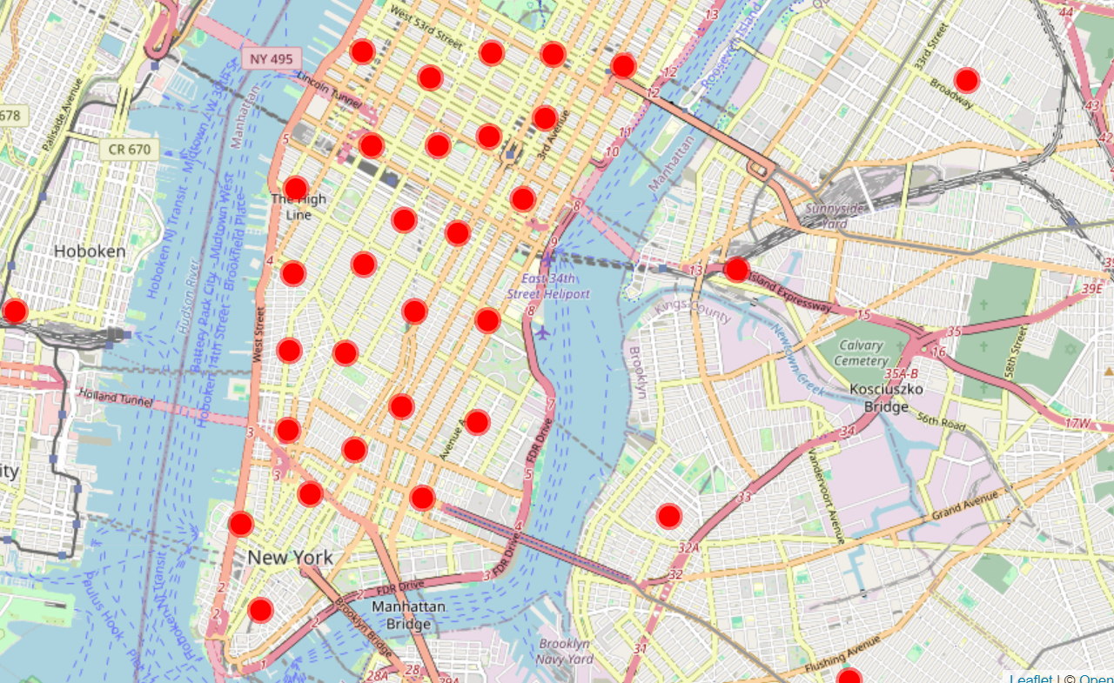
ClusteringData Analytics :
Finding Bolt Hotspot
Clustering with KNN : k = 50
Centroids

Slide 18
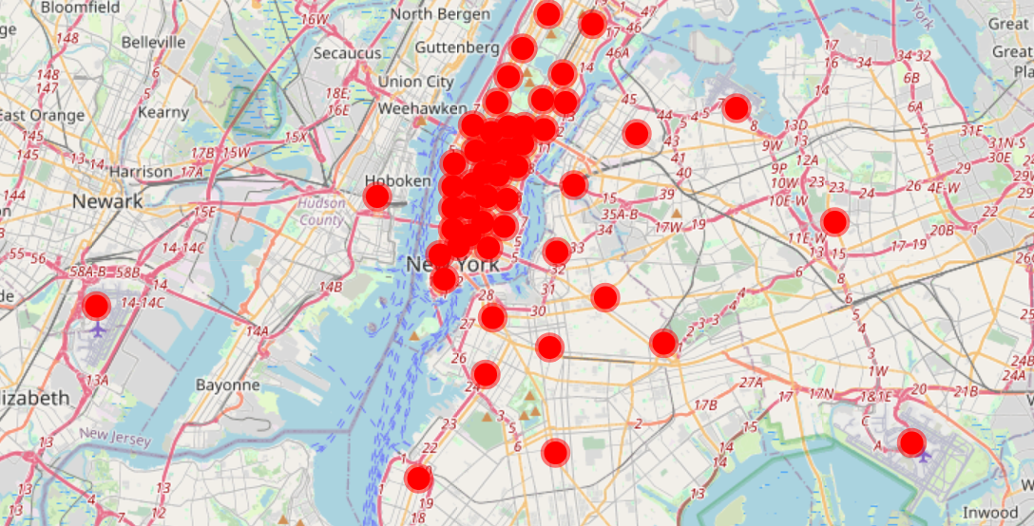
Data Analytics :
Finding Bolt Hotspot
Clustering with KNN : k = 50
Centroids

Slide 19



Persona , cible our customers
→ MONEY
Both locals and tourists use Bolt, but for slightly different reasons. Locals tend to use it as a complement to the public transportation system, while tourists may rely on it more heavily to simplify getting around the city.
Lives in the downtown (or work there)
People that go out ,
Visit touristic places

Slide 20
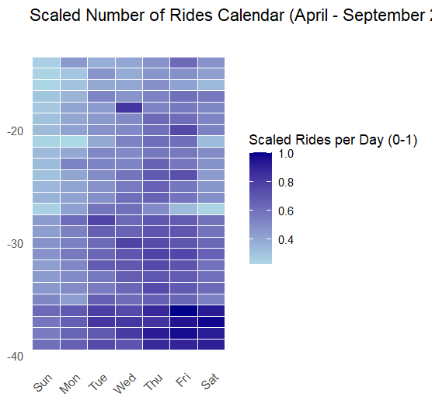
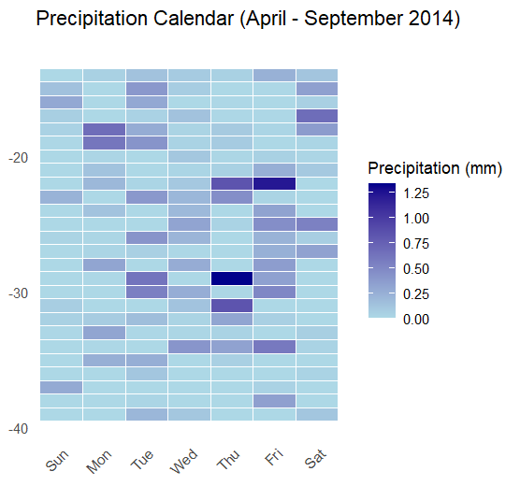
Data Analytics :

Slide 21
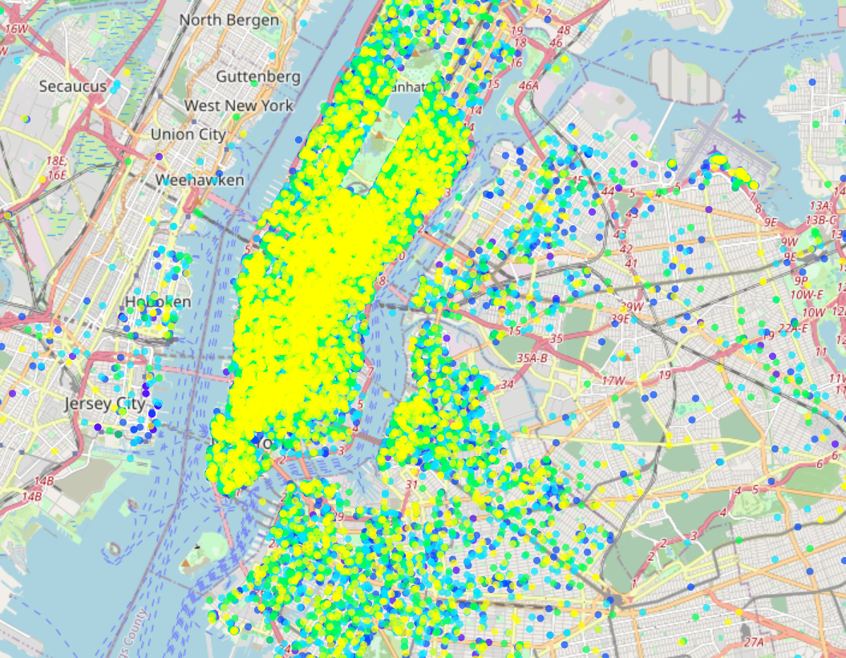
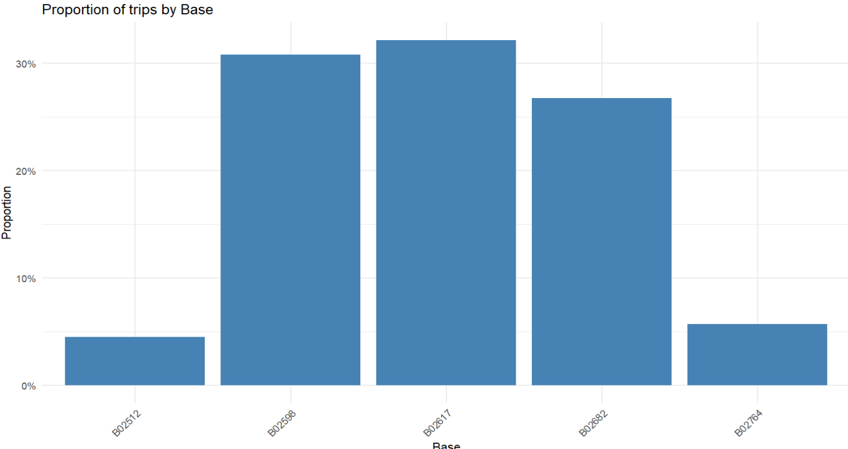
Data Analytics :
Base distribution:

Slide 22
Temporal Patterns Beyond Daily Peaks

Slide 23
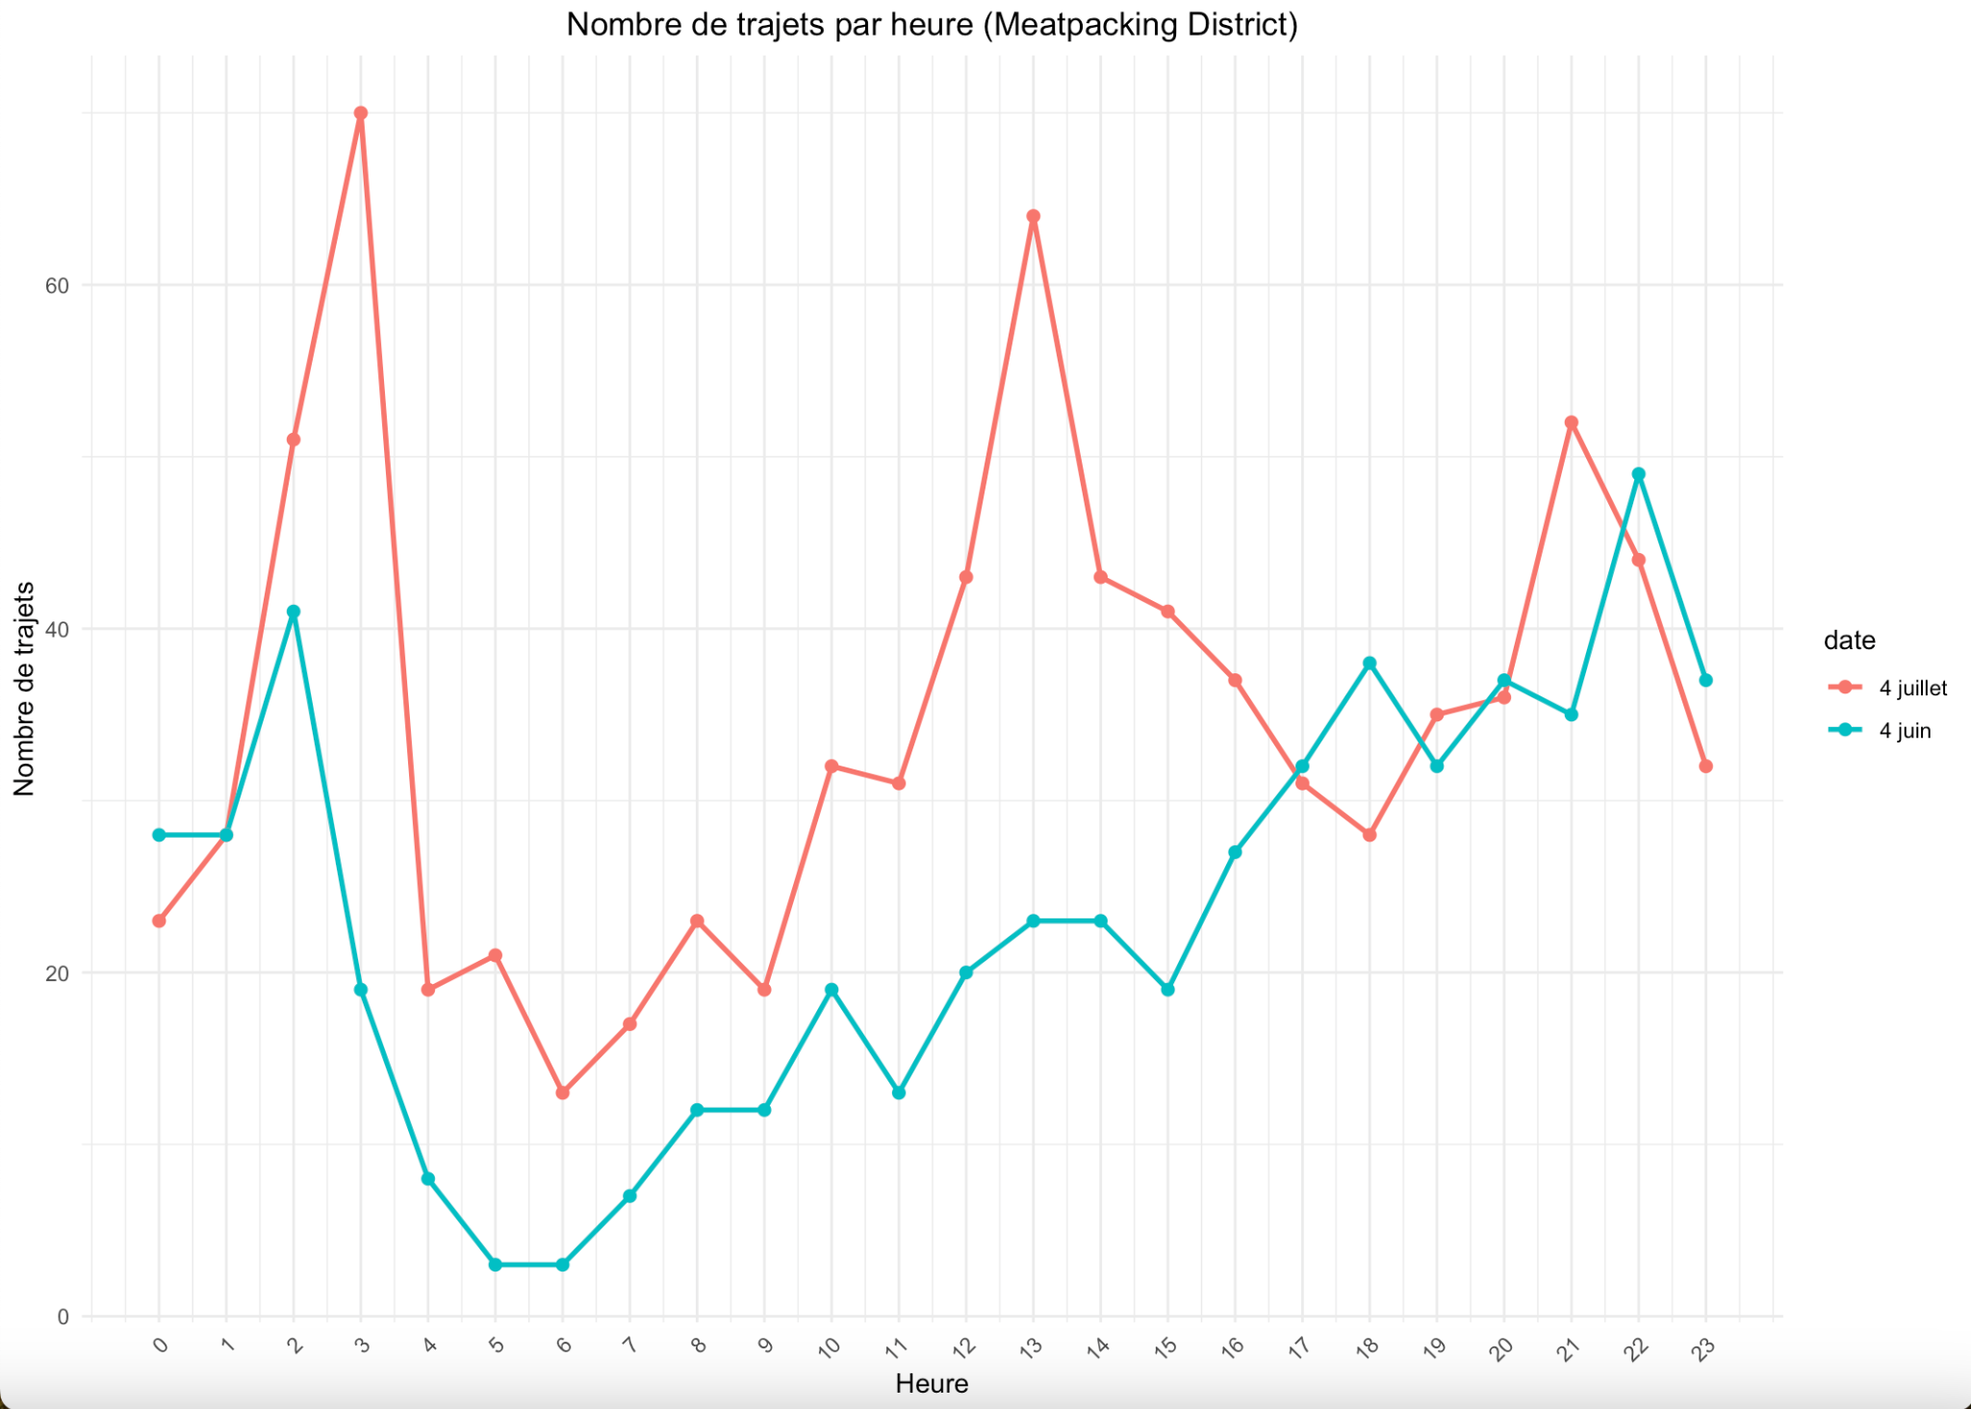
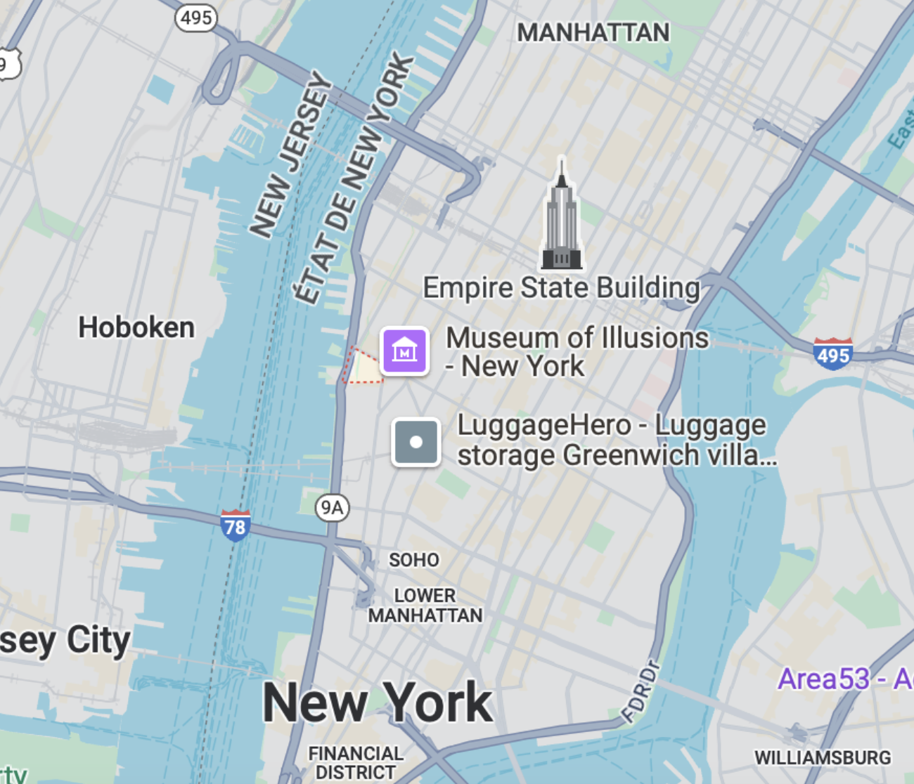
Meatpacking District on the 4th of July
Notes:
Présentation Meatpacking district + fête du 4 juillet

Slide 24
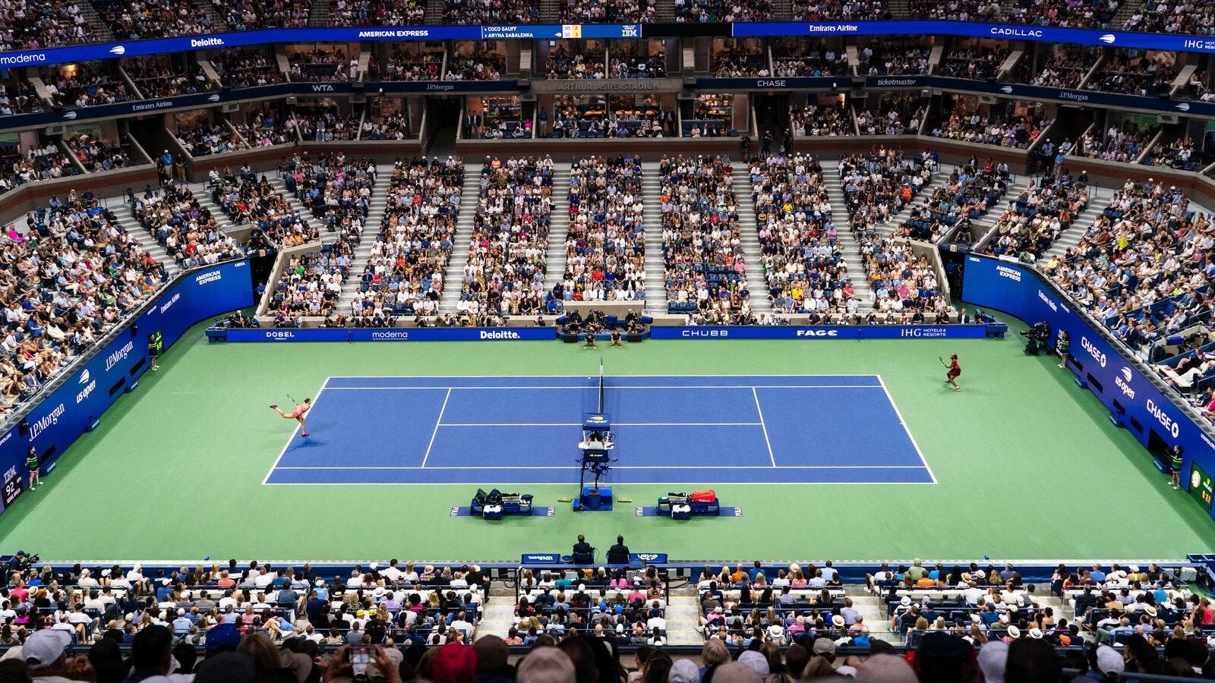
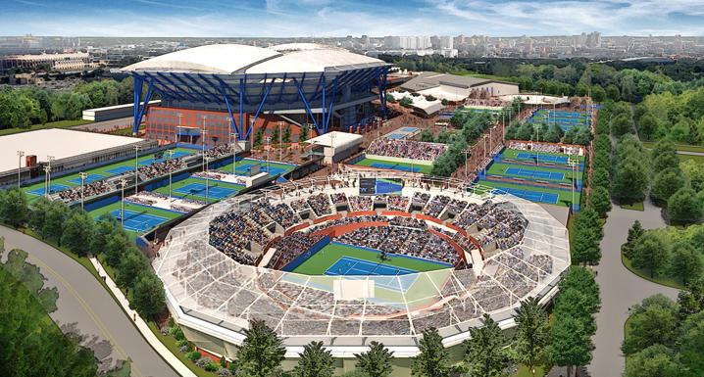
US Open Tennis
Notes:
Présentation US Open tennis sur la période du 25 août au 8 septembre 2014

Slide 25
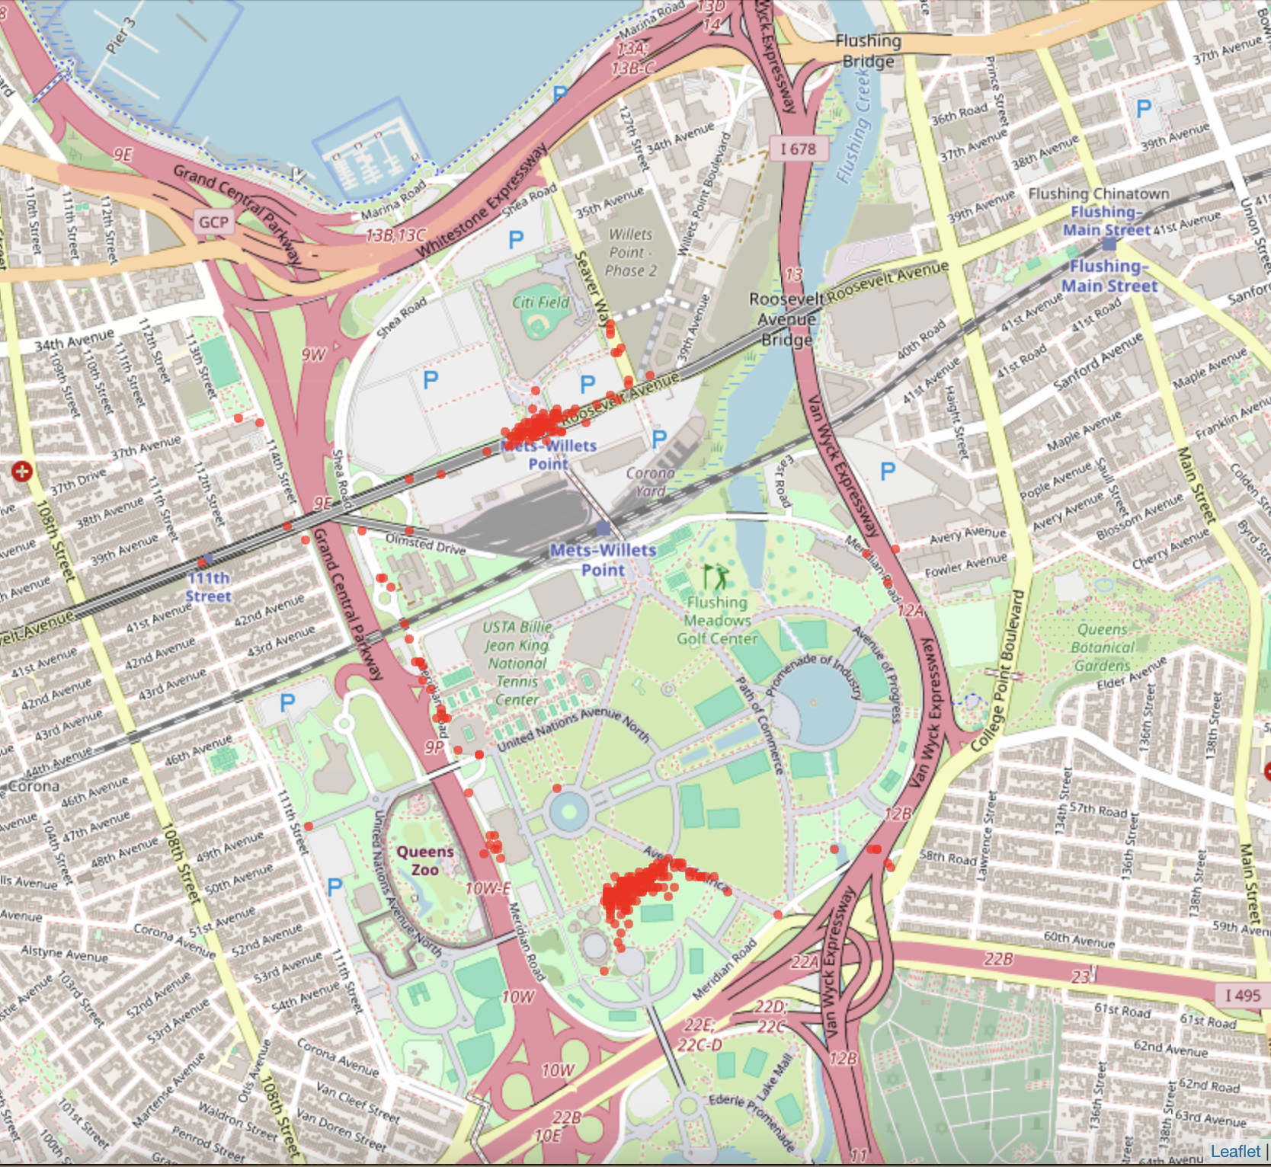
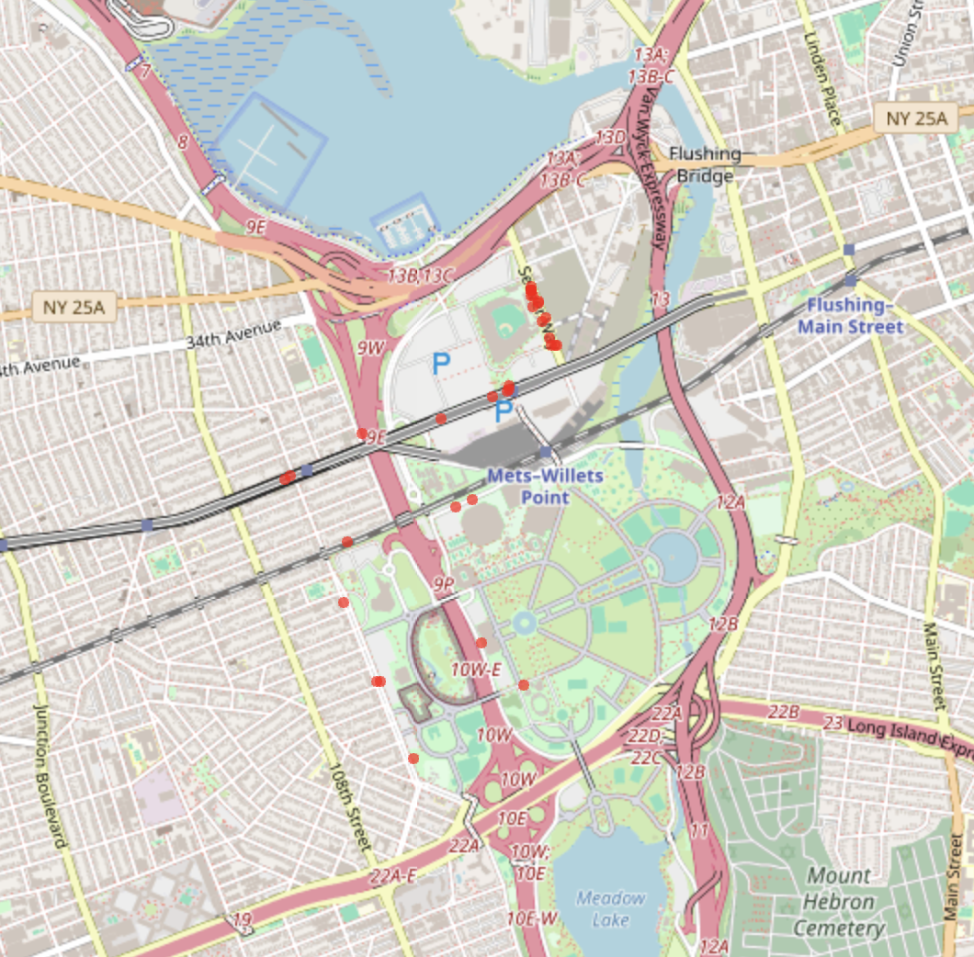
US Open Tennis
415 rides on the 3rd of September
32 rides on the 1st of August
Notes:
Présentation US Open tennis sur la période du 25 août au 8 septembre 2014 + montrer que chaque point est un début de trajet sur une journée donnée

Slide 26
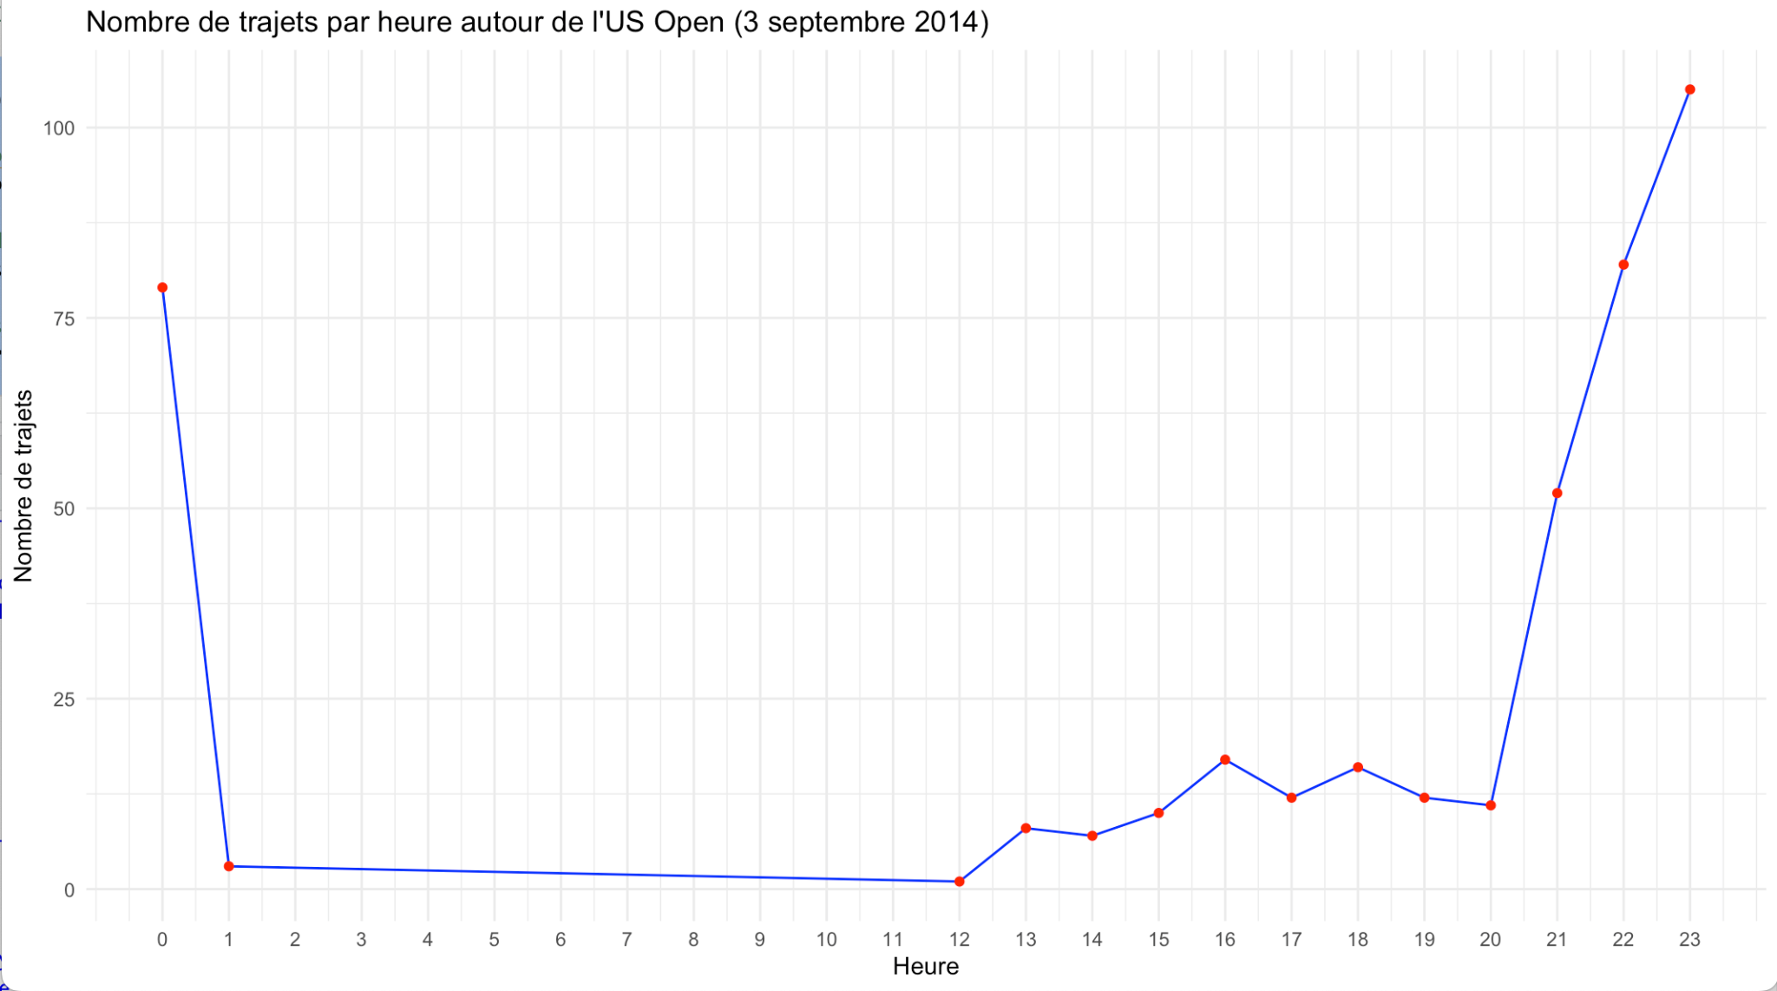
US Open Tennis
Notes:
Présentation US Open tennis sur la période du 25 août au 8 septembre 2014 + montrer que chaque point est un début de trajet sur une journée donnée

Slide 27
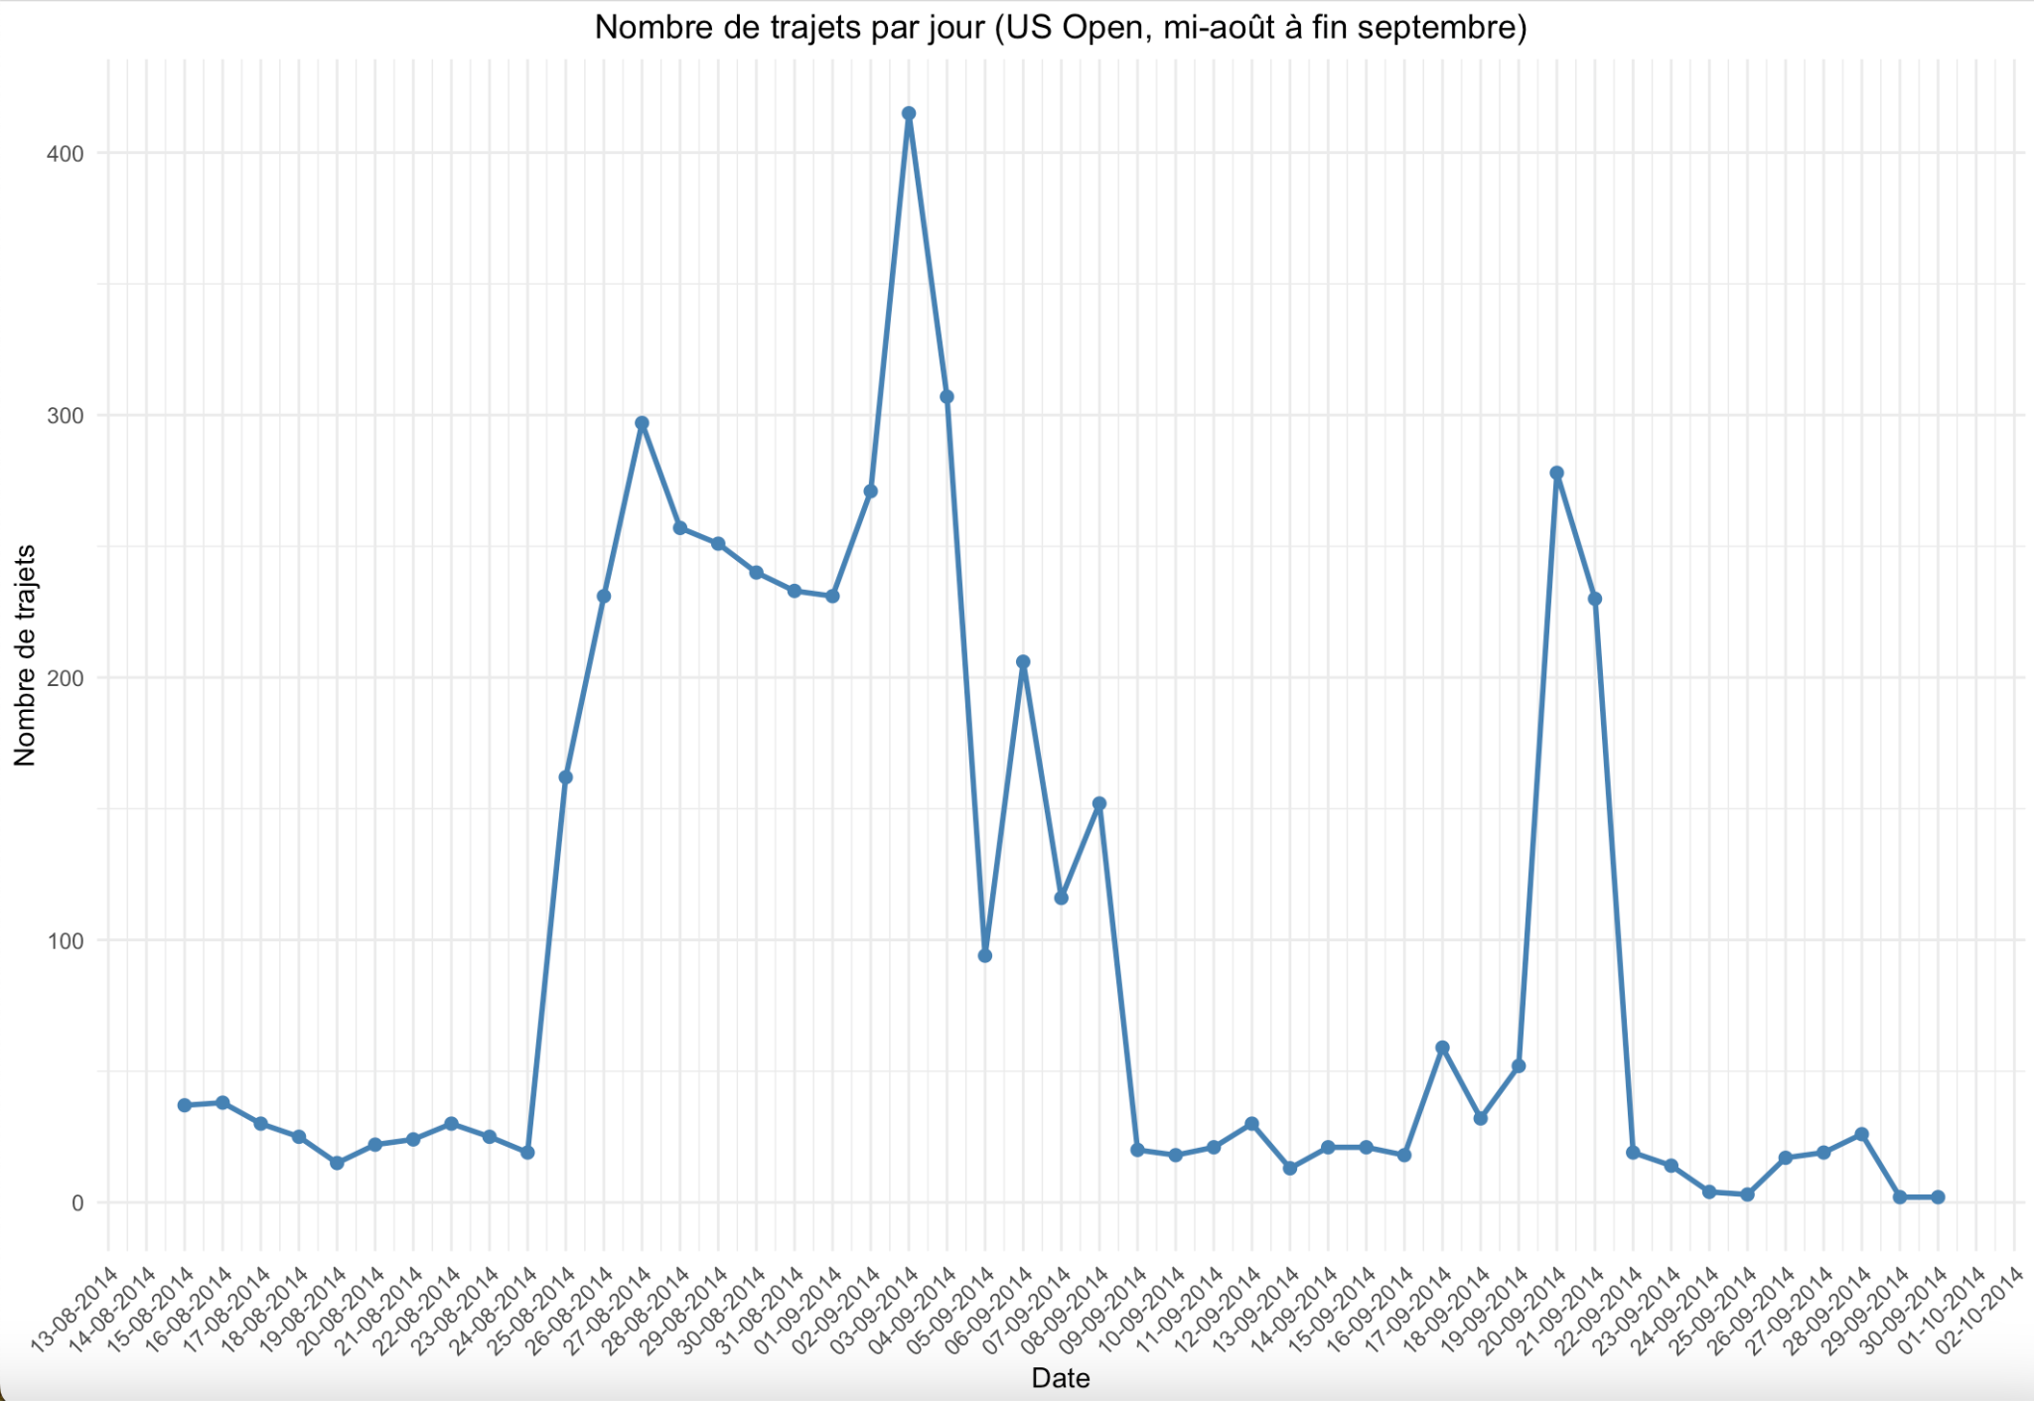
US Open Tennis
3 important dates :
27th of August
3rd of September
20th of September
Notes:
Analyse du nombre de trajet sur la période de l’US Open => 3 dates ressortent

Slide 28


US Open Tennis
Rafael Nadal
Serena Williams
Roger Federer
Notes:
Ces dates correspondent # - pic1 : Roger Federer and Serena Williams (quart) qui jouent
# - pic2 : Nadal et Williams (demi)
# - pic3 : final femme avec Serena Williams

Slide 29
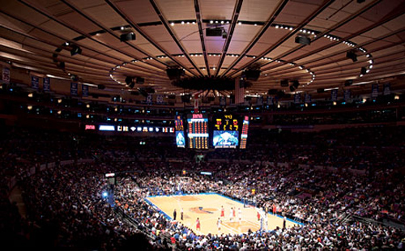

Madison Square Garden
Notes:
Présentation du Madison Square Garden + évènements là bas : matchs de basket des Knicks, et des matchs de hockey des Rangers, concert, des évènements politiques ou combats de boxe

Slide 30
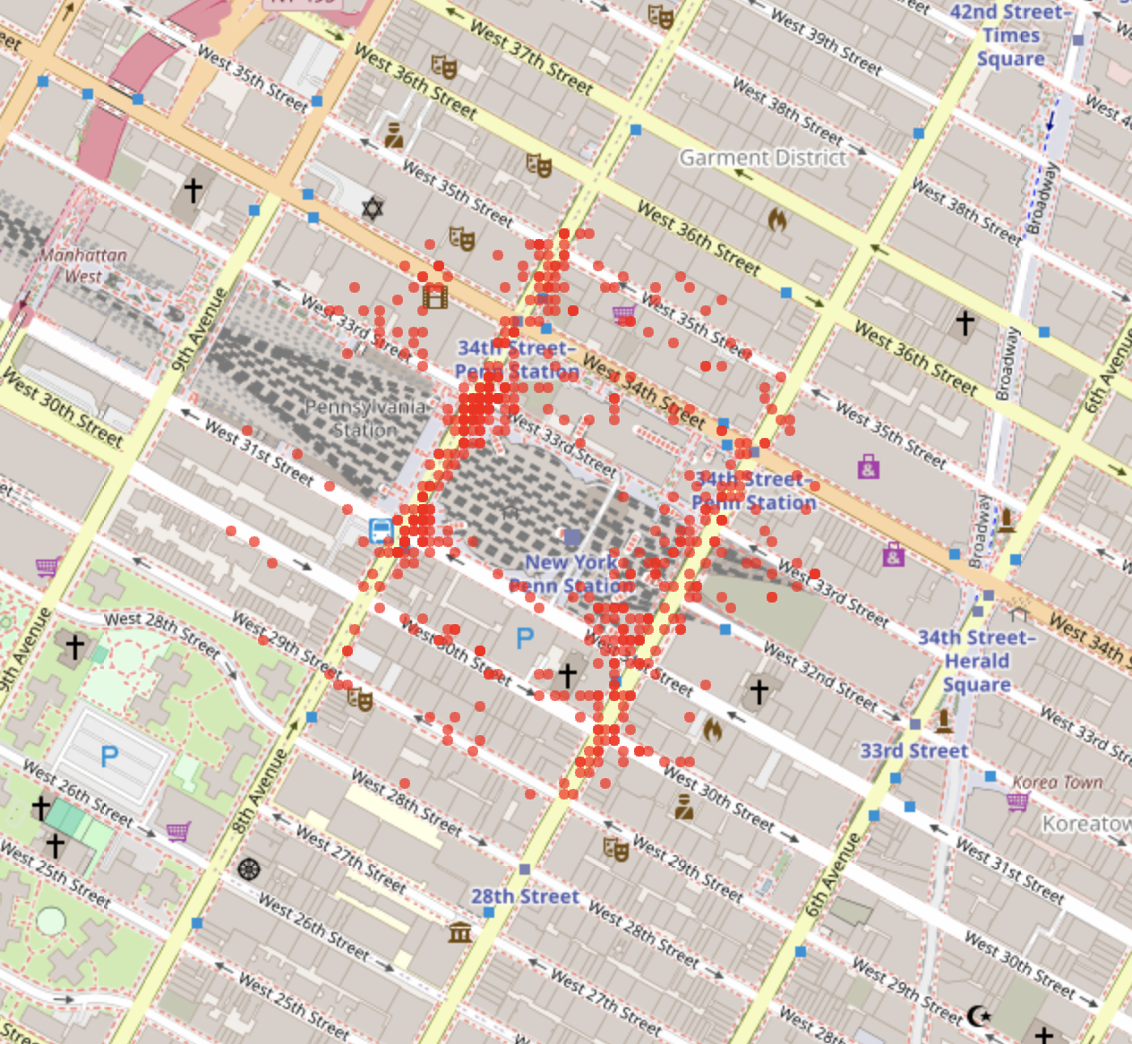
Madison Square Garden
544 rides on the 15th of July
Notes:
Présentation du Madison Square Garden + évènements là bas : matchs de basket des Knicks, et des matchs de hockey des Rangers, concert, des évènements politiques ou combats de boxe

Slide 31
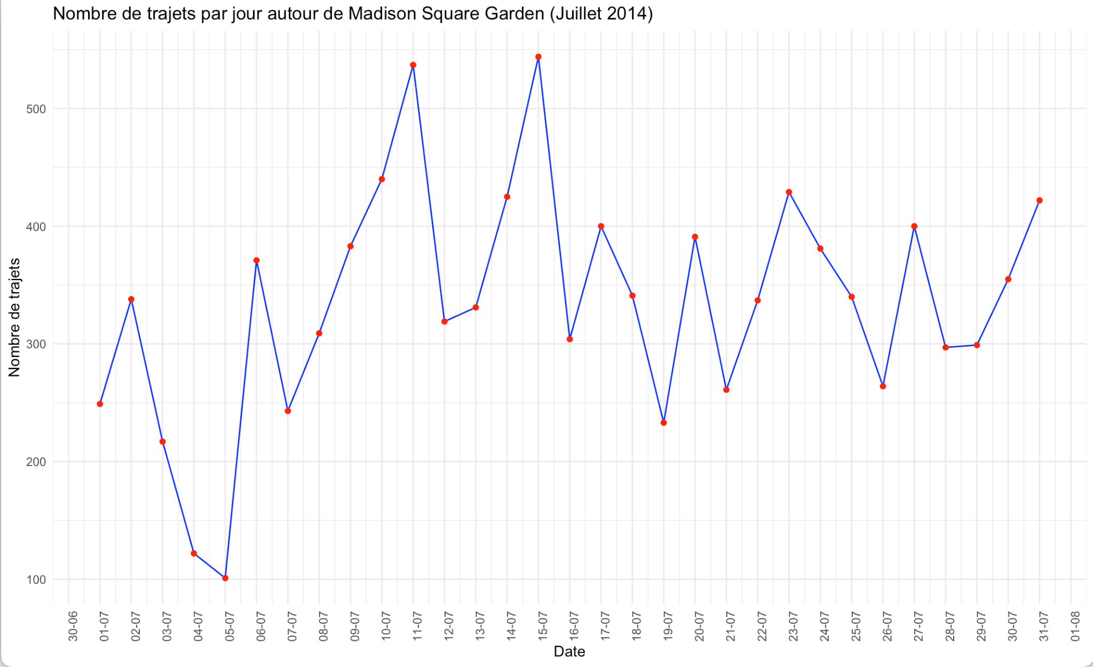
Madison Square Garden

Slide 32
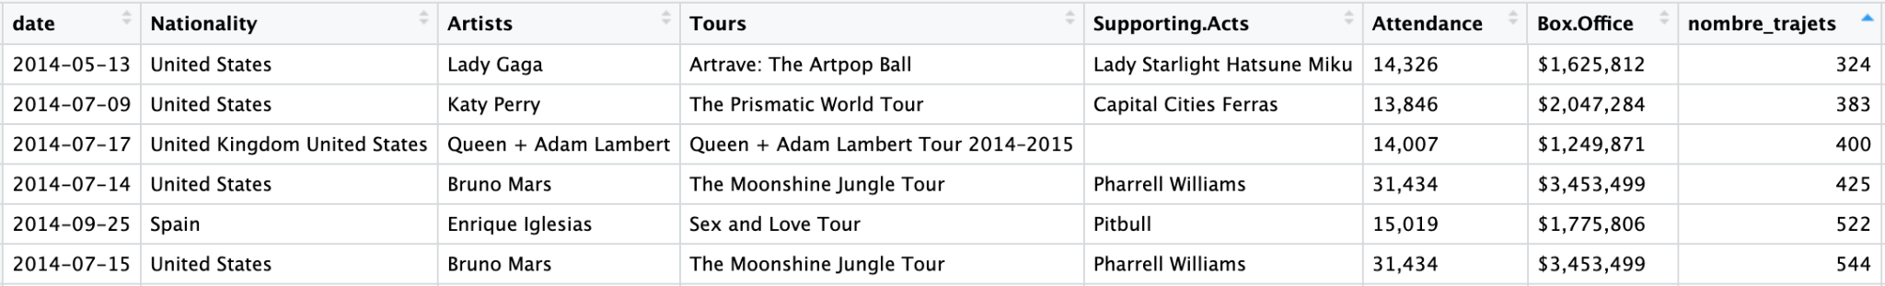
Madison Square Garden - Events 2014
Notes:
Liste des évènements musicaux en 2014 => prédictions du nombre de trajet par rapport aux évènements de 2015

Slide 33
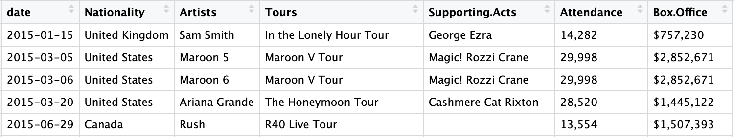
Madison Square Garden - Events 2015
Notes:
Liste des évènements musicaux en 2014 => prédictions du nombre de trajet par rapport aux évènements de 2015

Slide 34
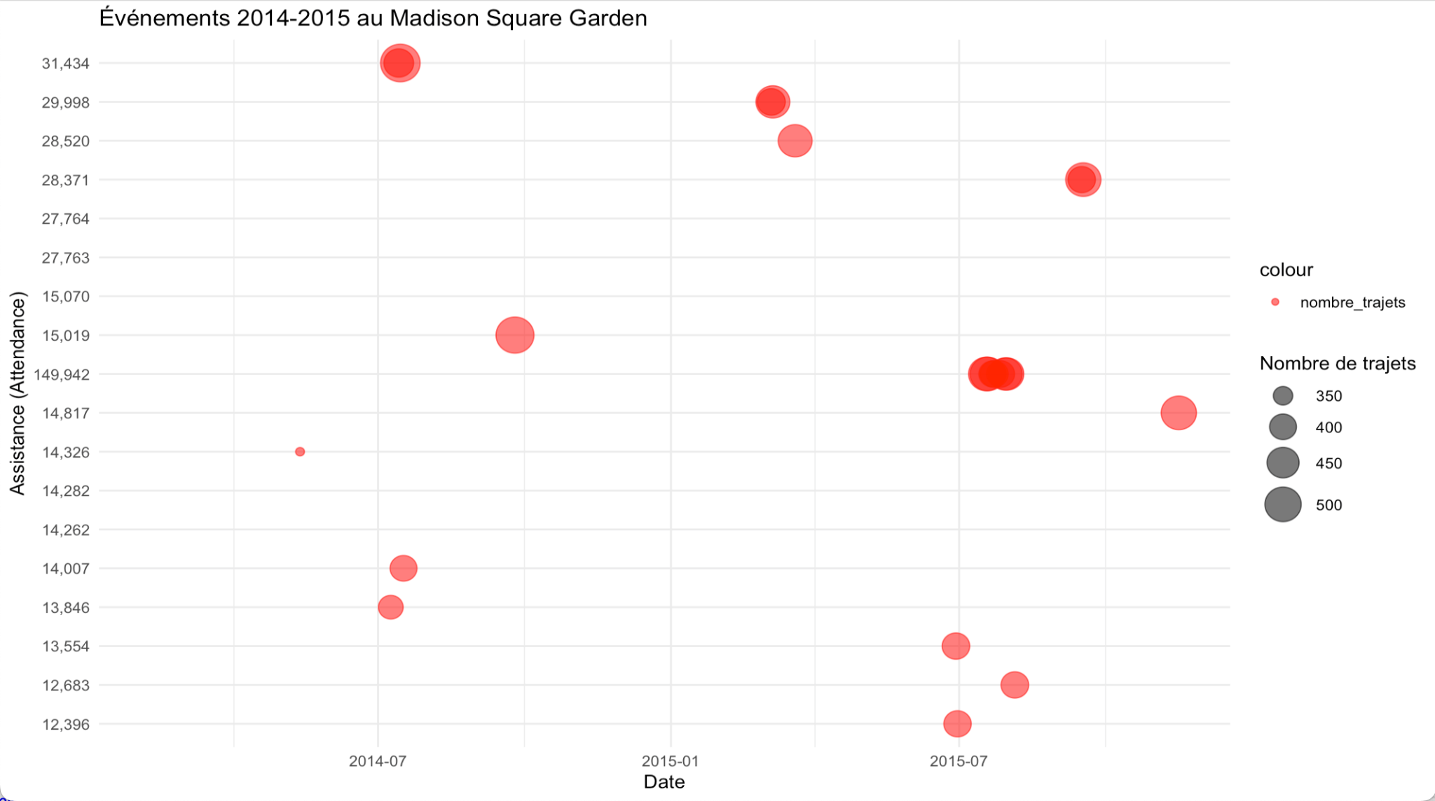
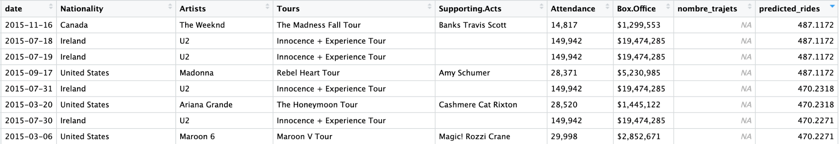
Madison Square Garden - Events 2015 predicted rides

Slide 35
Prediction

Slide 36
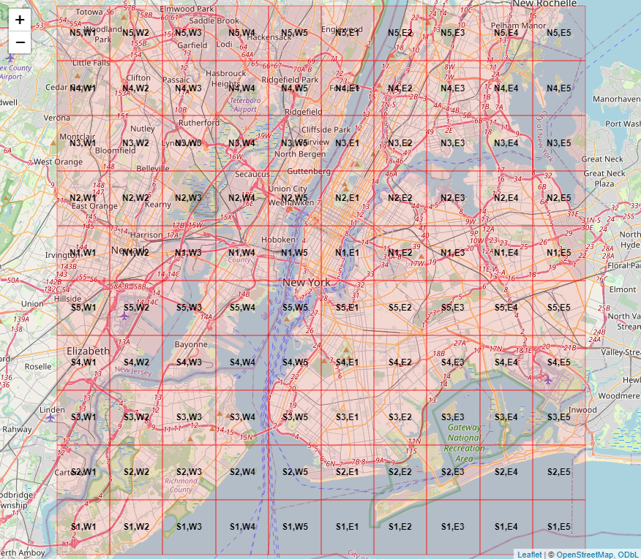
Prediction Preparation:
Feature Engineering
Time-Based Features
Weekend marker (binary)
Weekday = 0
Weekend (Sat/Sun) = 1
Hour Categories:
Night, Morning, Afternoon & Evening
Data Sampling & Cleaning
Sample size: 10% of original dataset
Geographical boundaries (New York City):
Latitude: 40.51°N - 40.90°N
Longitude: 74.24°W - 73.74°W
Area divided into 100 zones (10x10 grid)
Location Grid System
Latitude zones: S1-S5 (South), N1-N5 (North)
Longitude zones: W1-E5 (West to East)
Notable zones:
Highest density: S2-E1 (22.9 points/km²)
Average area per zone: 18.1 km²

Slide 37
Prediction Preparation: Weather Categories & Normalization
Temperature Ranges (Fahrenheit)
Maximum Temperature (tmax):
Low: 44.0°F - 76.0°F
Medium: 76.0°F - 84.5°F
High: 84.5°F - 95.0°F
Minimum Temperature (tmin):
Low: 32.5°F - 61.5°F
Medium: 61.5°F - 69.0°F
High: 69.0°F - 78.0°F
Average Temperature (tavg):
Low: 38.2°F - 69.5°F
Medium: 69.5°F - 77.0°F
High: 77.0°F - 86.0°F
Precipitation Categories
None: 0 inches
Light: 0 - 0.1 inches
Heavy: > 0.1 inches
Normalized Variables
All numeric features scaled:
Latitude & Longitude
Temperature metrics (max/min/avg)
Precipitation
Hour

Slide 38
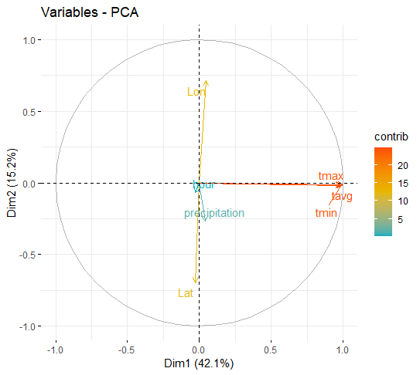
Prediction Preparation: Principal Component Analysis & Association Rules
PCA Results
Analysis of 7 normalized numeric variables:
3 components explain 71.78% of variance
PC1 dominant: 42.12% of variance
99.22% variance captured by 5 components
Key Association Rules
Strongest patterns:
S4 zone weekday activity → E5 zone (lift: 21.03)
High confidence patterns in S4-E5 area during:
High temperatures (max & avg)
Weekdays
Support: 1-1.7%
Confidence: >50%

Slide 39
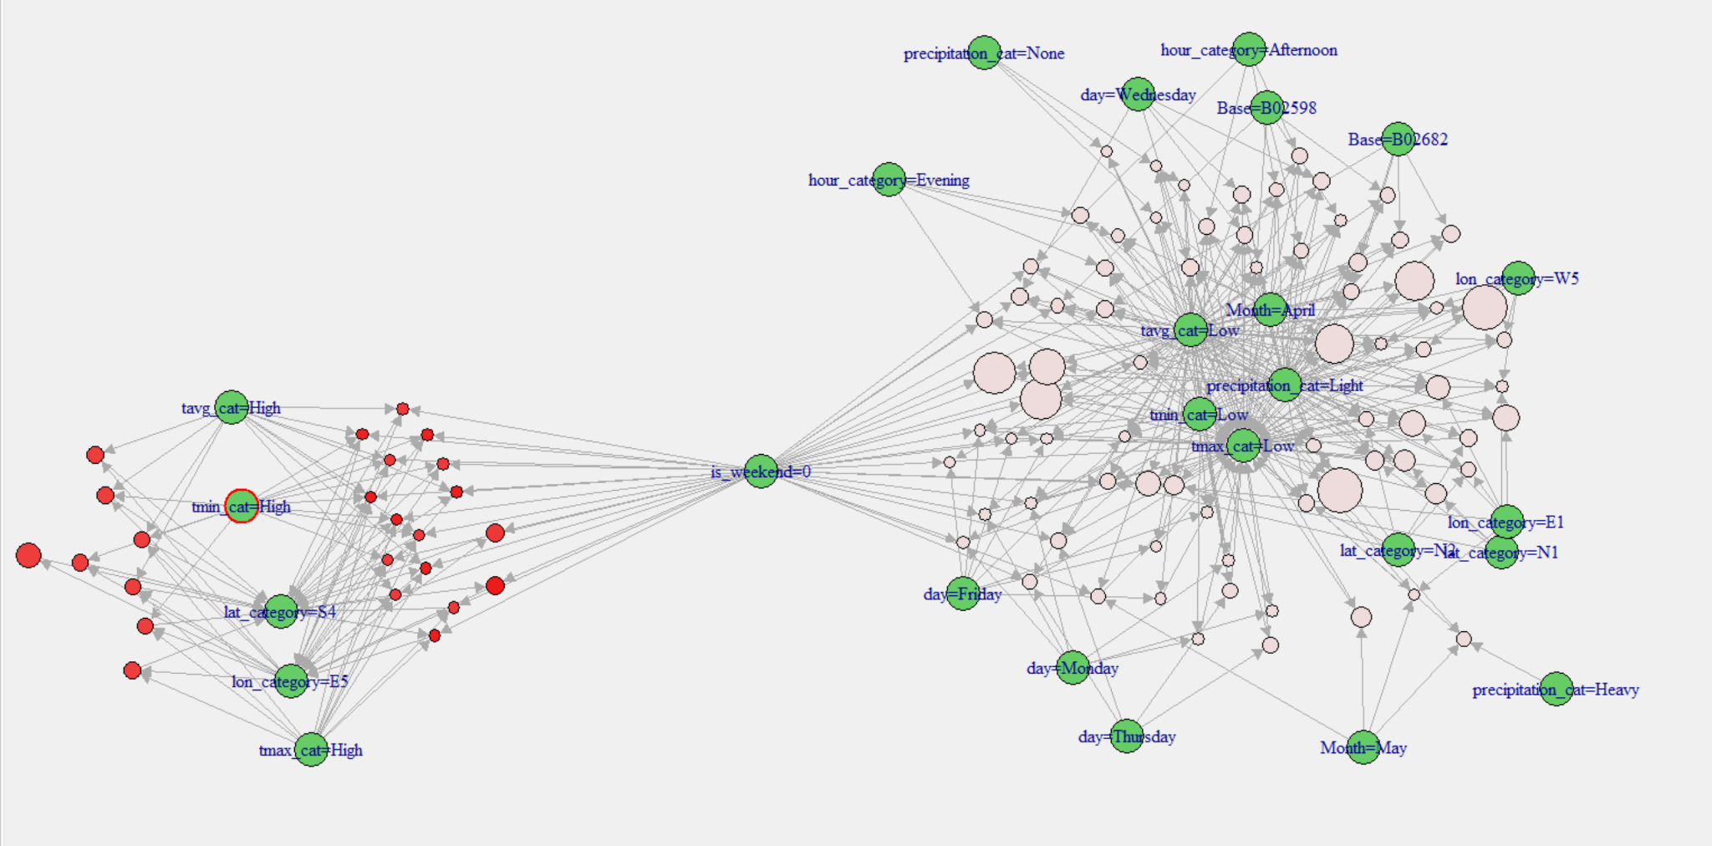
Network of Strong Association Rules

Slide 40
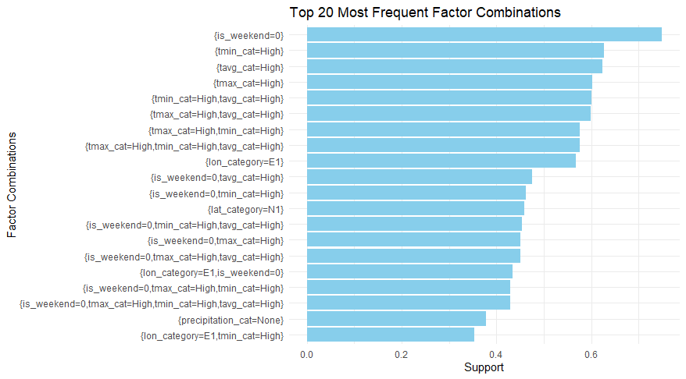
Prediction Preparation:
Frequent Pattern Analysis
Time Patterns:
Weekday trips: 74.99%
Evening trips: 35.36%
Afternoon trips: 33.41%
Weather Combinations:
High temperatures dominate:
Min temp (High): 62.68%
Avg temp (High): 62.45%
Max temp (High): 60.19%
No precipitation: 37.82%
Location Distribution:
Most active zones:
E1: 56.82%
N1: 45.87%
N2: 32.88%
Key Insights:
Weekday activity dominates
High temperature periods show consistent patterns
Strong geographical preferences (E1, N1 zones)

Slide 41
Modeling: Data Preparation & Split
Model 1: Basic Features Approach
Target Variable: Hourly ride count
Selected Features:
Location-based:
E1, N1, N2 zone ratios
Weather conditions:
High temperature (all metrics)
Precipitation status
Average temperature
Time-based:
Weekend indicator
Hour of day
Data Processing:
Aggregation: Hourly level
Split ratio: 70/30 (train/test)

Slide 42
Modeling: Enhanced Features Engineering
Model 2: Advanced Temporal Features
Time-Based Features:
Basic temporal:
Week number, Month
Day of week
Rush hours (7-9AM, 4-7PM)
Night hours (10PM-5AM)
Weather-Event Interactions:
Rainy rush hour
Hot day (>85°F)
Outdoor event conditions
Weather impact on events
Event Indicators:
Holidays/Breaks:
Major holidays (Memorial, Independence, Labor Day)
School breaks (Spring, Summer)
Special Events:
Sports: Yankees games
Cultural: Tribeca, Shakespeare, Pride Week
Major: US Open, Fashion Week
Data Processing:
Aggregation: Hourly level
Split ratio: 70/30 (train/test)

Slide 43
Prediction Models & Optimization
Linear Regression
Simple linear model
Feature interactions not considered
Direct interpretability of coefficients
Random Forest
Base configuration:
500 trees
Default parameters
Basic feature relationships
Optimized Random Forest
Enhanced with:
Parallel processing
Grid search optimization
Cross-validation (5-fold)
Parameter tuning:
Number of variables at each split
Minimum node size
Split rules

Slide 44
Model Performance Evaluation: Basic model
Model | RMSE | R²
Linear Regression | 45.46 | 0.50
Random Forest | 34.60 | 0.72
Optimized RF | 34.01 | 0.73
Key Improvements:
Random Forest:
24% RMSE reduction vs Linear Regression
42% increase in R² score
Optimized RF Settings:
Best parameters:
mtry = 4
splitrule = extratrees
min.node.size = 5
Minor improvement over base RF (+1%)

Slide 45
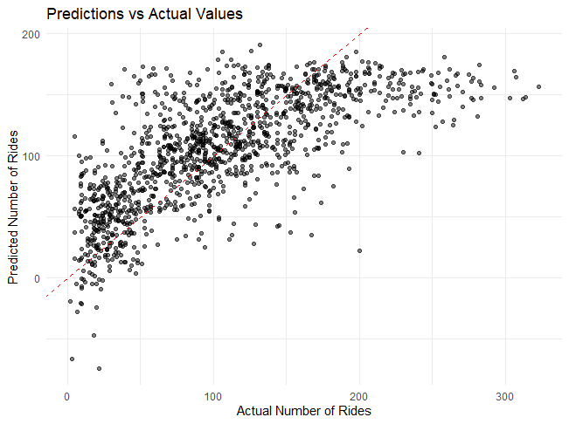
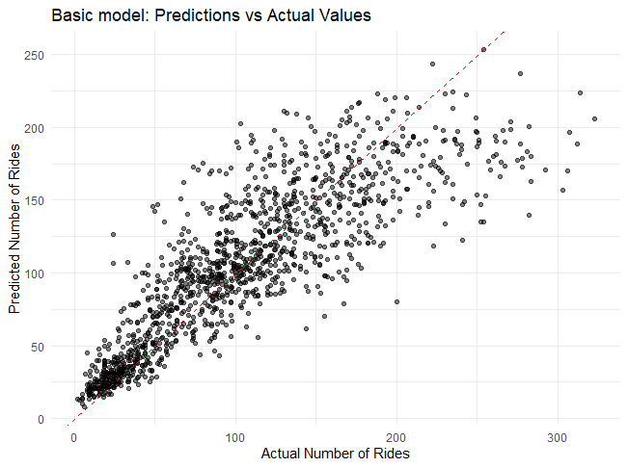
Linear Regression
Optimized RF
Model Performance Evaluation: Basic model

Slide 46
Model Performance Evaluation: Advanced temporal model
Performance Results:
RMSE: 21.01
R² score: 0.90
Major Improvements vs Basic Model:
RMSE: -38% (from 34.01 to 21.01)
R² score: +23% (from 0.73 to 0.90)
Optimized Configuration:
Parameters:
mtry = 6
splitrule = variance
min.node.size = 1
Key Success Factors:
Enhanced feature engineering:
Time-based features (rush hours, nights)
Special events integration
Weather-event interactions
Seasonal patterns

Slide 47
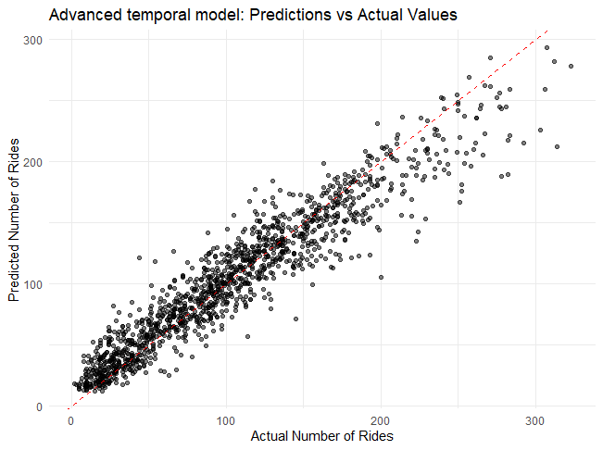
Model Performance Evaluation: Advanced temporal model

Slide 48
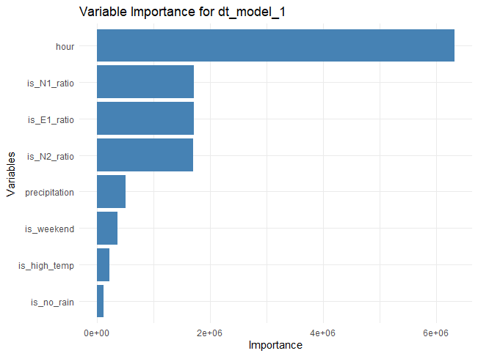
Prediction Analysis: Basic model

Slide 49
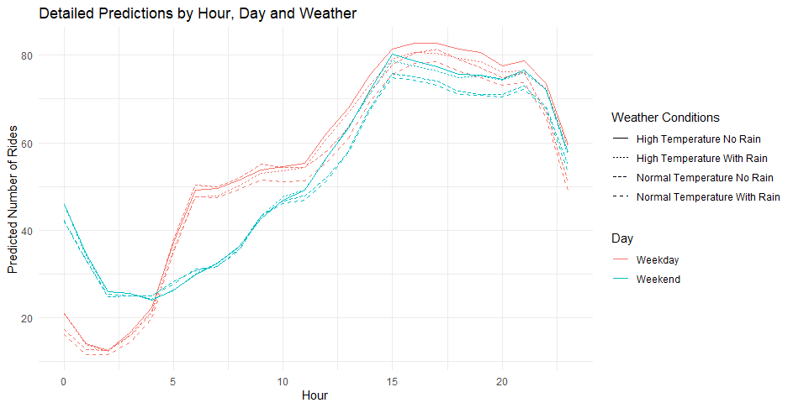
Prediction Analysis: Basic model
Scenario:
Time: 8:00 AM
Weekday
Location: E1 zone
Weather:
High temperature
Light precipitation (0.1")
No continuous rain
Prediction: 47.39 rides expected in this hour

Slide 50
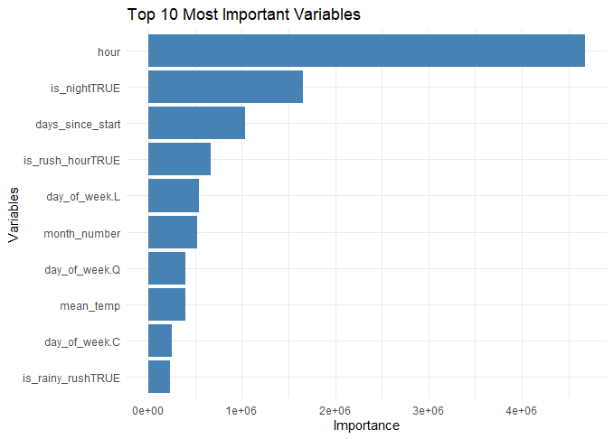
Prediction Analysis: Advanced temporal model

Slide 51
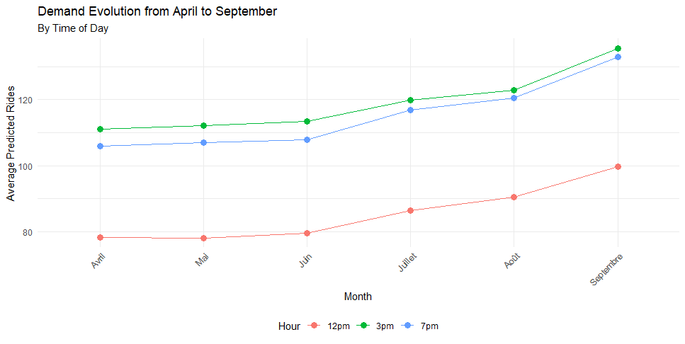
Prediction Analysis: Advanced temporal model

Slide 52
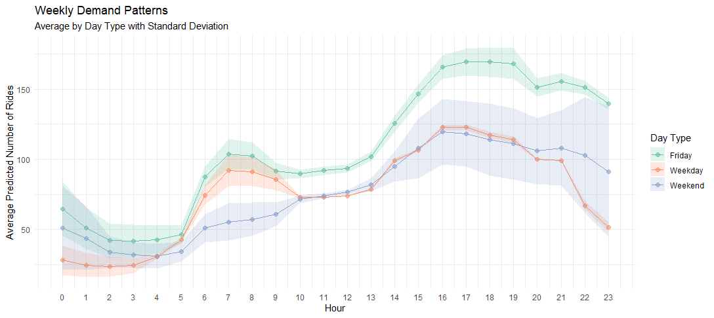
Prediction Analysis: Advanced temporal model

Slide 53
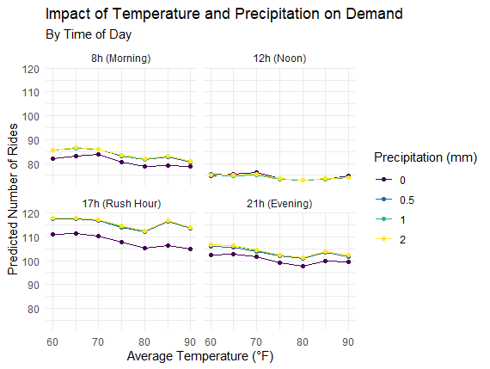
Prediction Analysis: Advanced temporal model

Slide 54

Prediction Analysis: Advanced temporal model

Slide 55


Prediction Analysis: Advanced temporal model

Slide 56

Prediction Analysis: Advanced temporal model

Slide 57
Strategic recommendations

Slide 58
Strategic recommendations : Peak Hour Management
Real-time data integration (weather, holidays, events)
Dynamic fleet management
Reduced customer wait times

Slide 59
Strategic recommendations : Customer Experience
Predictive analytics for personalized offers
Loyalty programs for frequent users and tourists
Enhanced customer satisfaction and retention

Slide 60
Strategic recommendations : Resource Allocation Optimization
Real-time resource adjustments
Continuous evaluation of resource use
Prevent driver shortages or overstaffing

Slide 61
Strategic recommendations : Data Integration
External data sources (traffic, events, public transit)
Real-time event updates for driver deployment
Partnerships with local event organizers

Slide 62
Strategic recommendations : Scalability and Future Growth
Flexible, scalable predictive models
Real-time data inputs for dynamic customer behavior
Continuous refinement of models due to a growing user base

Slide 63
Strategic recommendations : Handling Data Privacy and Security
Advanced encryption methods and Strengthen data privacy policies
Compliance with data privacy regulations
Privacy-preserving data analysis techniques to preserve specific user data

Slide 64
Conclusion

Slide 65
Summary of Achievements
Data Cleaning & Preparation
Data Analysis
Predictive Modeling
Visualization
Strategic Insights

Slide 66
Future Directions
Scalability
Advanced Data Integration
Real-time Adjustments
Continuous Model Improvement

